Slide 1
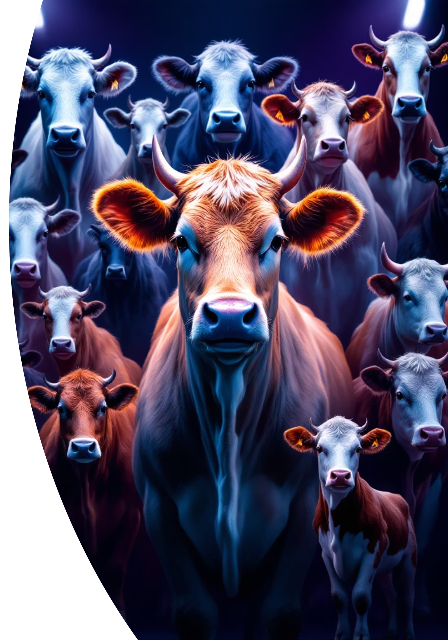
Cattle Breed Classification Using CNNs
A Comparative Study of ResNet18 and VGG16 with Transfer Learning
Samira Ismayilova, Agayeva Firuza, Gallacov Emil
Group CE 22.2, Baku Higher Oil School

Slide 2

Abstract: Key Findings
Transfer Learning Essential
ResNet18 + SGD Best
Monitoring with TensorBoard
Significantly improves performance.
Achieves best results on 50-class dataset.
Tracks accuracy and loss for insights.

Slide 3
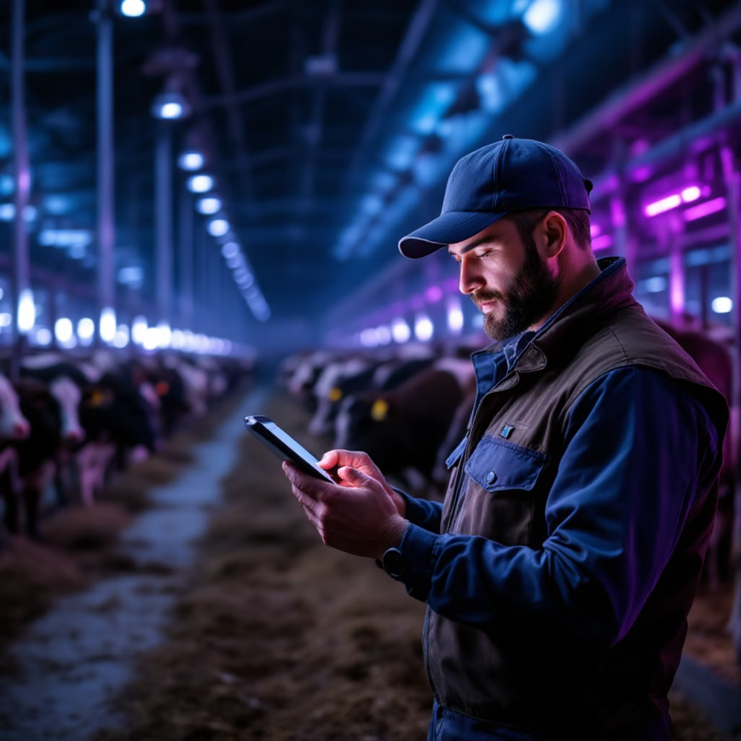
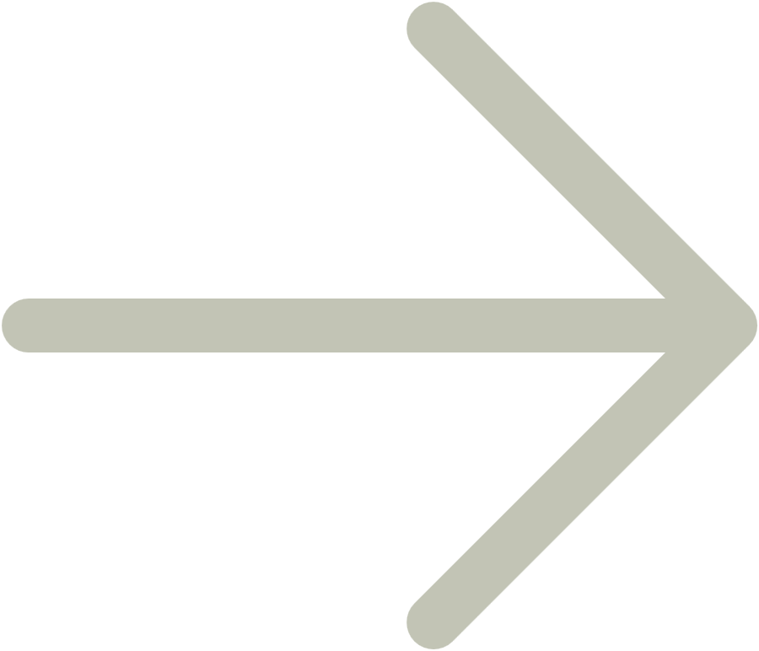
Introduction: Why Automate Cattle Recognition?
Manual identification is slow and subjective.
Deep learning offers scalable, objective solutions.
CNNs are state-of-the-art for image recognition.
Implement CNNs
Compare Optimizers
ResNet18 and VGG16 architectures.
SGD vs. Adam performance.
Evaluate Transfer Learning
Analyze with TensorBoard
Scratch vs. pre-trained models.
Accuracy and loss curves.

Slide 4
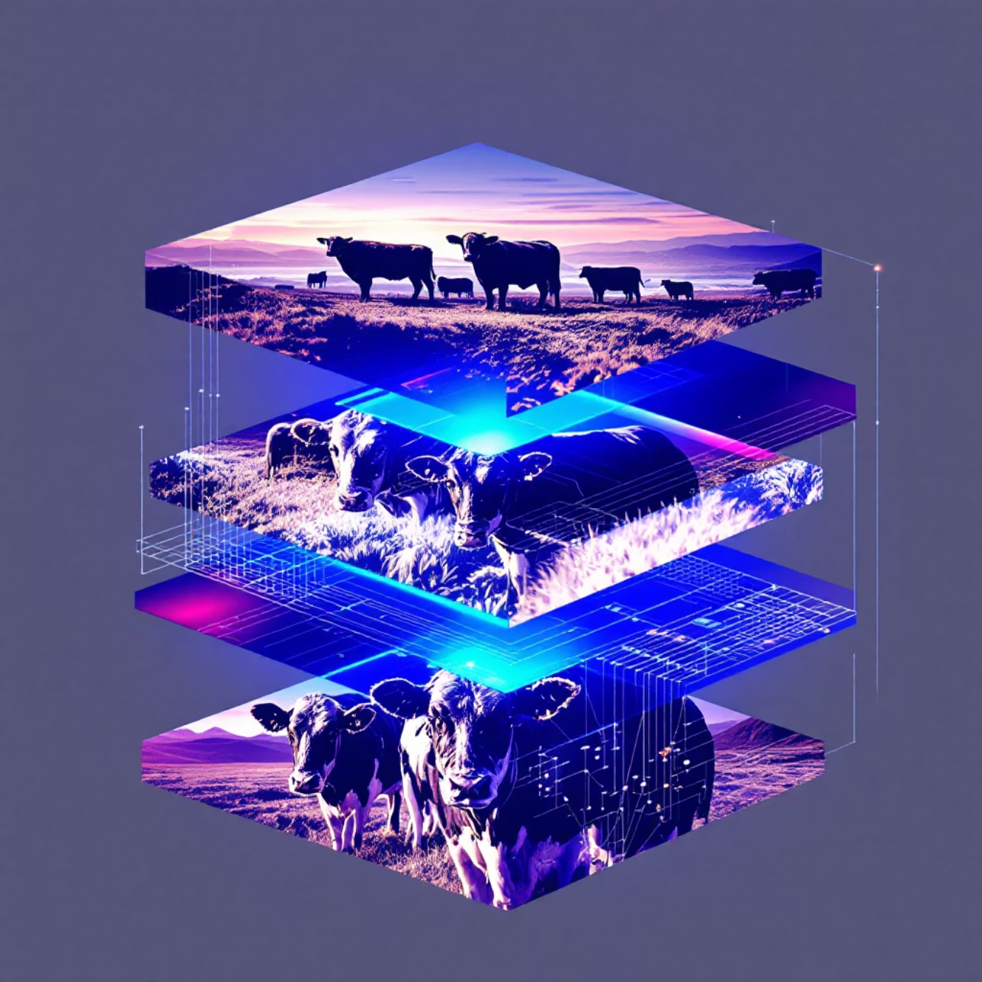
Dataset & Preprocessing
50
5949
Cattle Breeds
Training Images
Diverse dataset.
For model learning.
1254
1328
Validation Images
Test Images
For model tuning.
For final evaluation.
Images resized to 224 \times 224 pixels.
Training data augmented: random horizontal flip, rotation.
All images normalized with ImageNet mean/std.

Slide 5




Model Architectures
ResNet18 (TL)
ResNet18 (Scratch)
ImageNet-pretrained, final layer replaced for 50 classes.
Same architecture, randomly initialized.
VGG16 (TL)
ImageNet-pretrained, convolutional features frozen, classifier fine-tuned.

Slide 6

Training Setup
Common Settings
Epochs
Optimizers
ResNet18 (TL): 5
SGD: LR 0.001, momentum 0.9
Cross-entropy loss
ResNet18 (Scratch): 3
Adam: LR 0.0005
Batch size: 32
VGG16 (TL): 1 (due to size)
PyTorch, Google Colab (GPU)
Feature extractor frozen for transfer learning.
Best validation accuracy models saved.

Slide 7
Quantitative Results
ResNet18
Yes
SGD
0.5813
0.5319
ResNet18
Yes
Adam
0.4902
0.4455
ResNet18
No
SGD
0.1762
0.0991
VGG16
Yes
SGD
0.4495
0.3820
VGG16
Yes
Adam
0.3742
0.3560
ResNet18 (TL) with SGD achieves best performance.
Training from scratch performs poorly, highlighting transfer learning's importance.

Slide 8
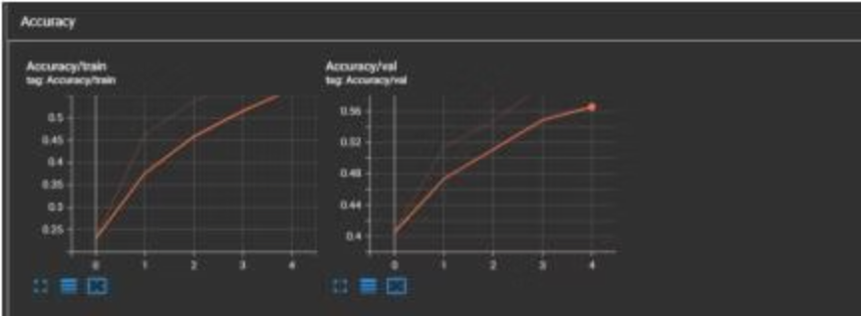
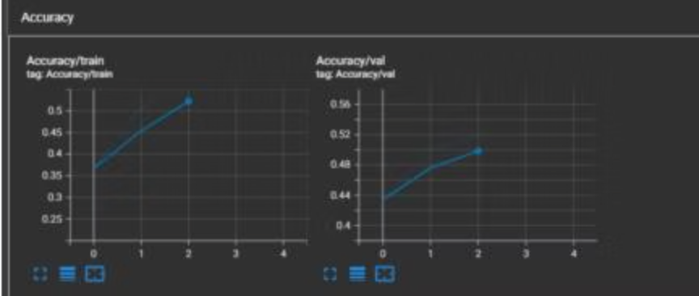
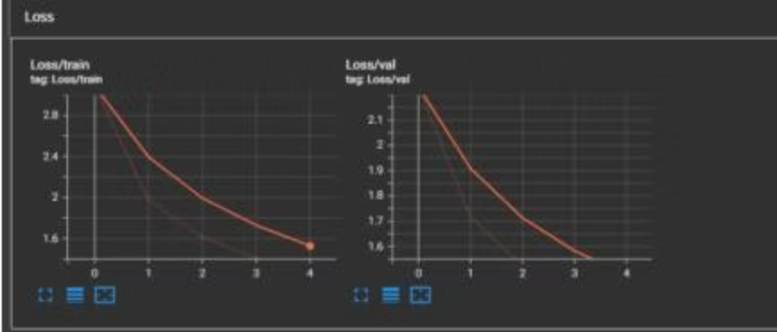
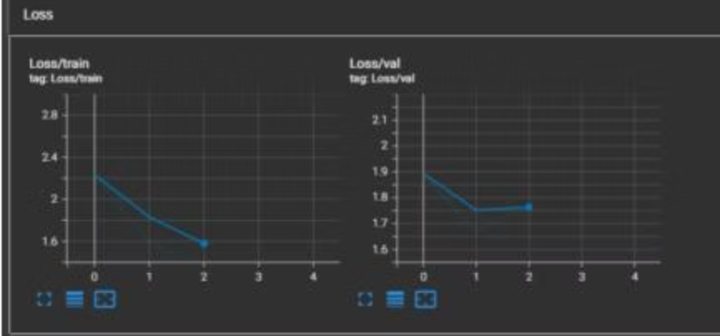
TensorBoard Insights: ResNet18
ResNet18 with SGD
ResNet18 with Adam
Stable training, good generalization, validation accuracy up to 59%.
Faster convergence, but lower saturation and larger train/validation gap.

Slide 9
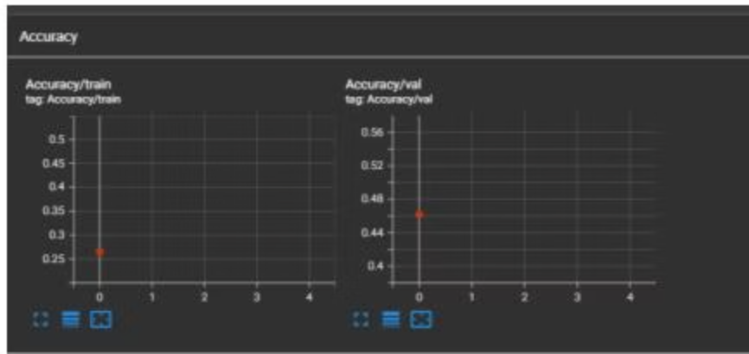
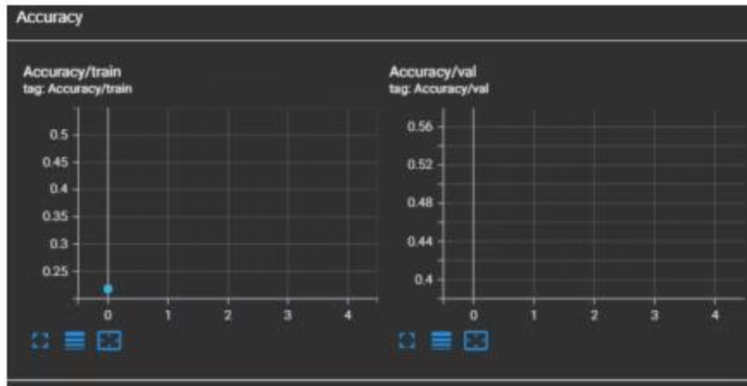
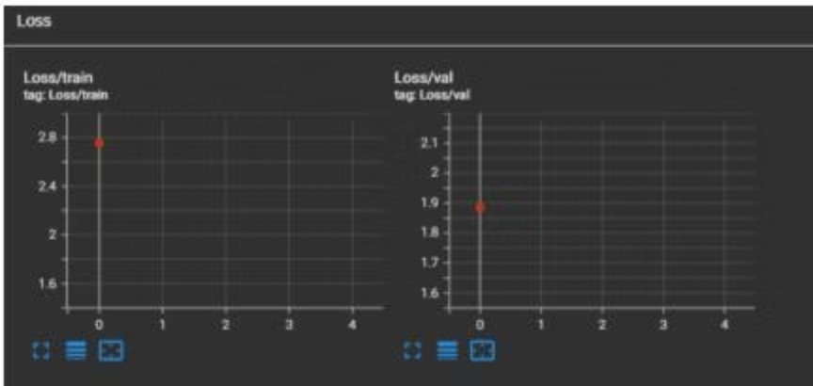
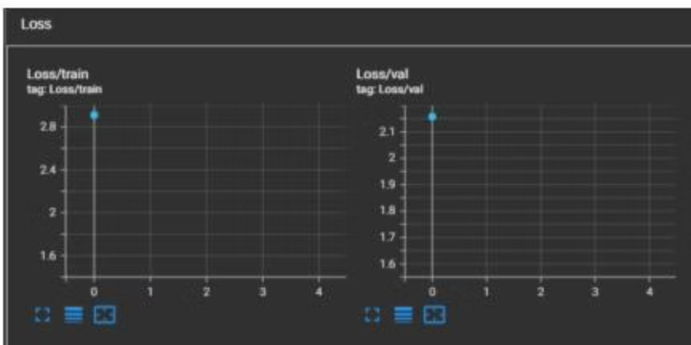
TensorBoard Insights: VGG16
VGG16 with SGD
VGG16 with Adam
Model still improving, more epochs likely needed for full convergence.
Fluctuating curves, reasonable accuracy for single epoch.

Slide 10
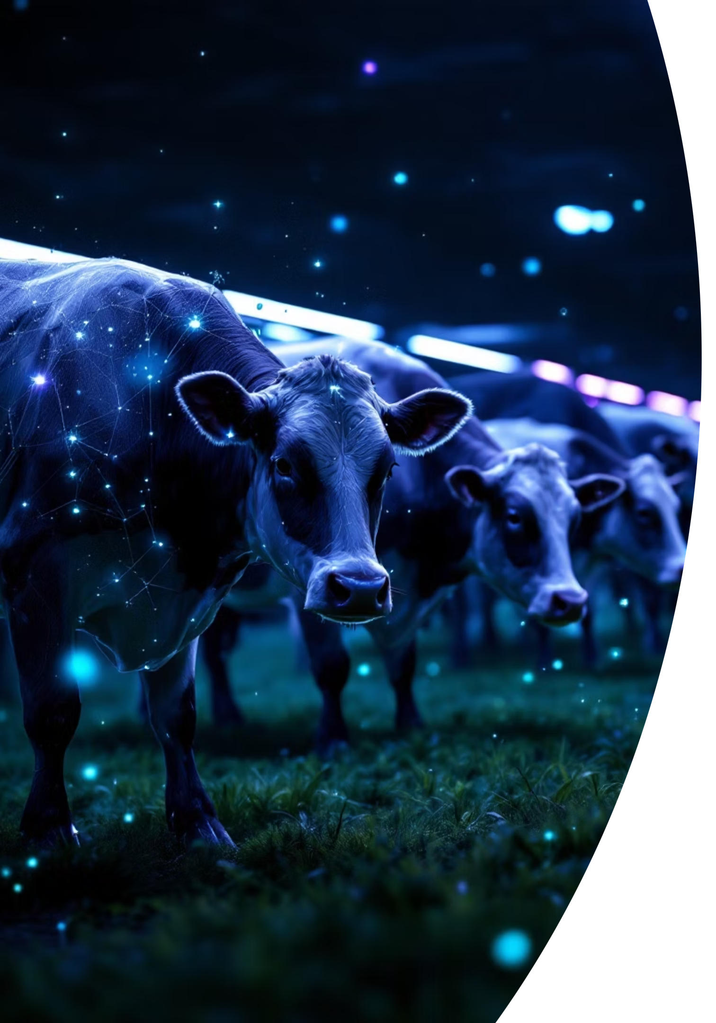
Conclusion & Future Work
Transfer Learning is Crucial
1
Essential for small datasets.
ResNet18 Outperforms VGG16
2
Easier optimization with residual connections.
SGD Generalizes Better
3
Adam converges faster but may overfit.
Best: ResNet18 with transfer learning and SGD (58.13% accuracy, 0.5319 macro F1).
Future work: Longer VGG16 training, class-balanced loss, advanced architectures.

Slide 11
Thank you

